Slide 1
Wimmera Information Portal (WIP)
17 April 2018

Slide 2
Partners to the project
Barengi Gadjin Land Council
Department of Health and Human Services
Department of Justice and Regulation Horsham
Federation University Australia
Goolum Goolum Aboriginal Cooperative
Grampians Community Health
Horsham Rural City Council
Victoria Police Horsham – Western District Division Four
Wimmera Drug Action Taskforce
Wimmera Primary Care Partnership
Wimmera Southern Mallee LLEN
Wimmera Uniting Care
Women’s Health Grampians
Yarriambiack Shire Council

Slide 3
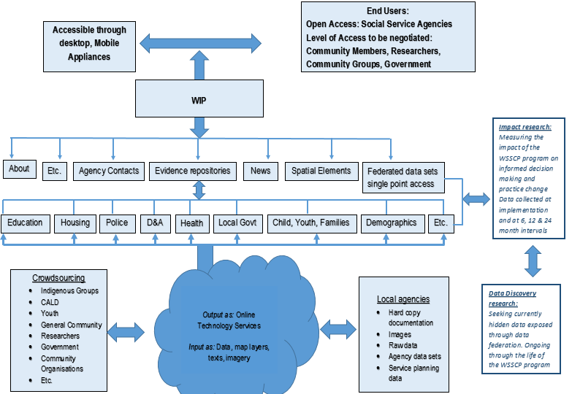

Slide 4
Initial scope
Demographic profile by LGA
Youth and child development
Education
Food and nutrition
Climate
Mental health
Alcohol and other drugs

Slide 5
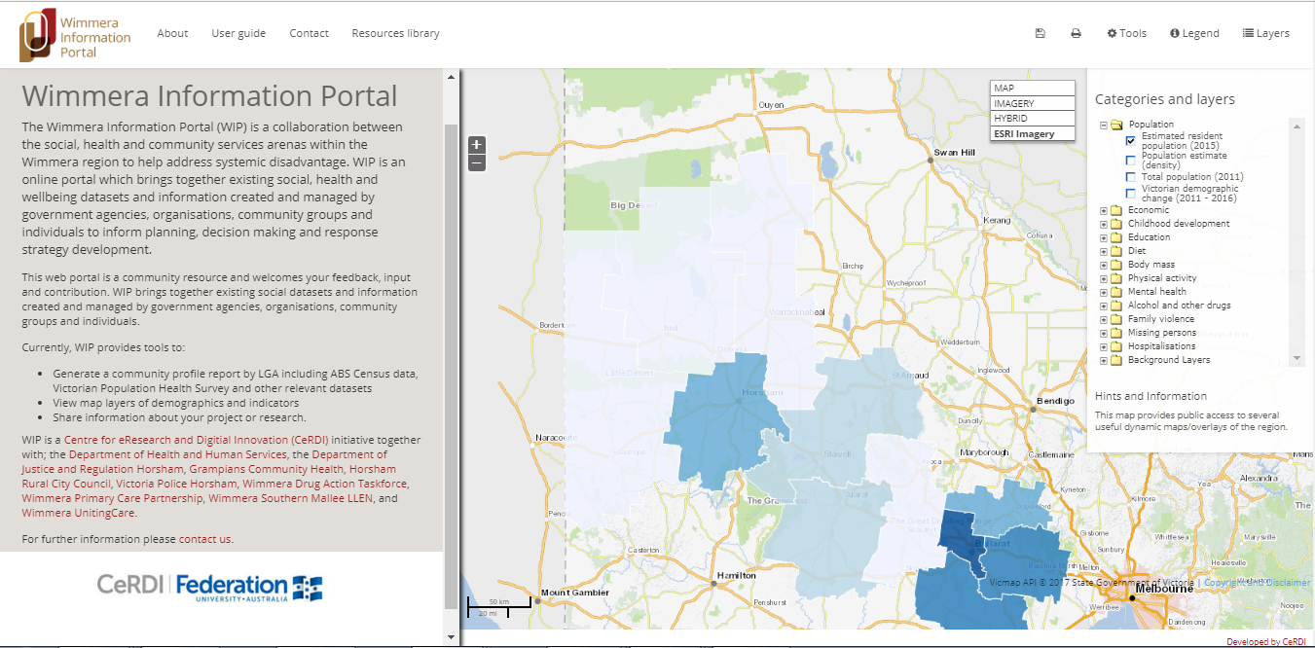

Slide 6
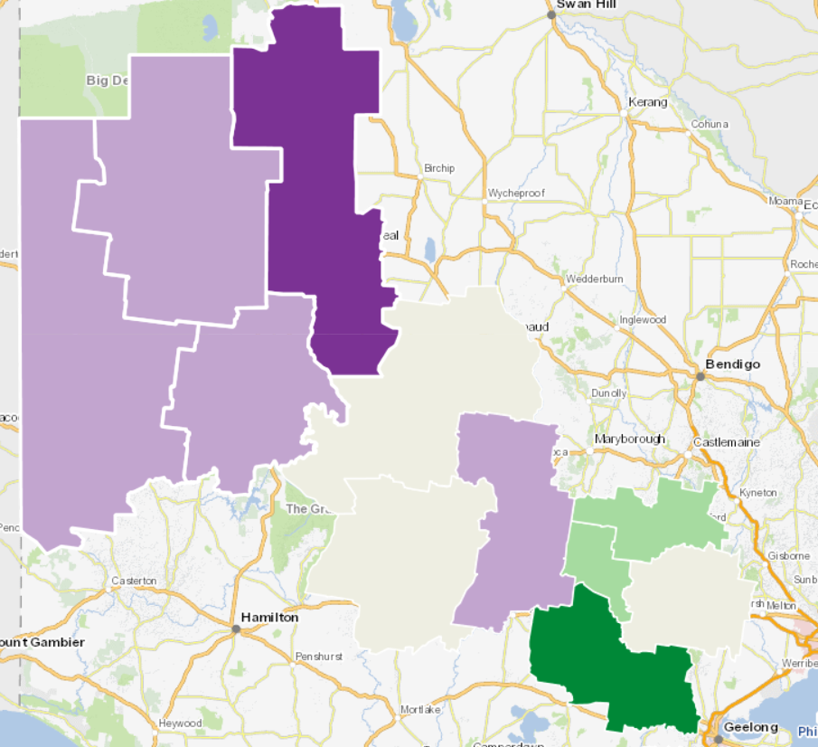
What have we mapped
Victorian Population Health Survey
Smoking
Fruit & Veg consumption
Sugar-sweetened drinks
Prevalence of Obesity
Physical Activity – Sedentary behaviour
Psychological distress
Social Health Atlas
Youth unemployment
Workforce participation
Public Hospital presentations
Children in low-income welfare dependent families
Source: VPHS 2012: Obese adults measured by BMI %

Slide 7
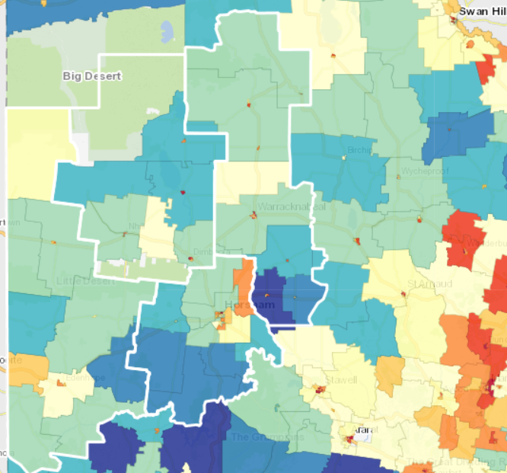
What have we mapped (cont)
ABS Census 2011
Population (Estimates and Projections)
Education (Post school qualifications)
SEIFA Indexes
Dept. Education and Training (VCAMS)
Year 12 Completions /School locations
Dept. Health and Social Services
Sport and Recreation Facilities
Australian Early Development Census
Developmentally vulnerable children
Victoria Police
Missing persons
Mental health warning flags
Family incidents
Source: ABS Census 2011: SEIFA Index of Education and Occupation (IEO) by SA1

Slide 8
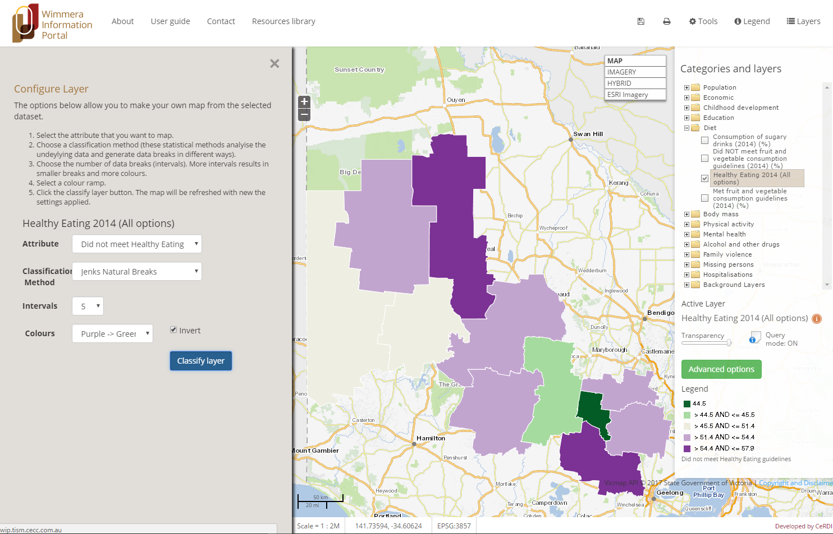
Proportion not meeting Healthy Eating Guidelines (by LGA)
Ability to configure the map. Reclassify and customise colour ramps

Slide 9
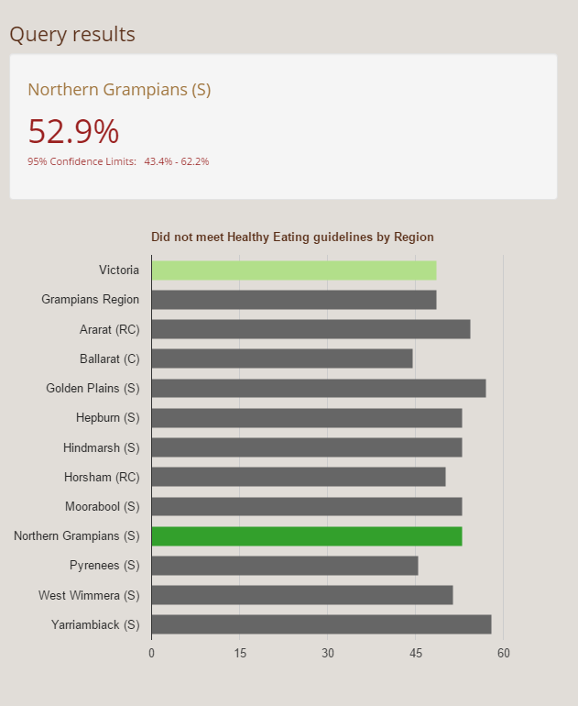
Proportion not meeting Healthy Eating Guidelines (by LGA)
Comparison with other LGAs, Victoria and Grampians region

Slide 10
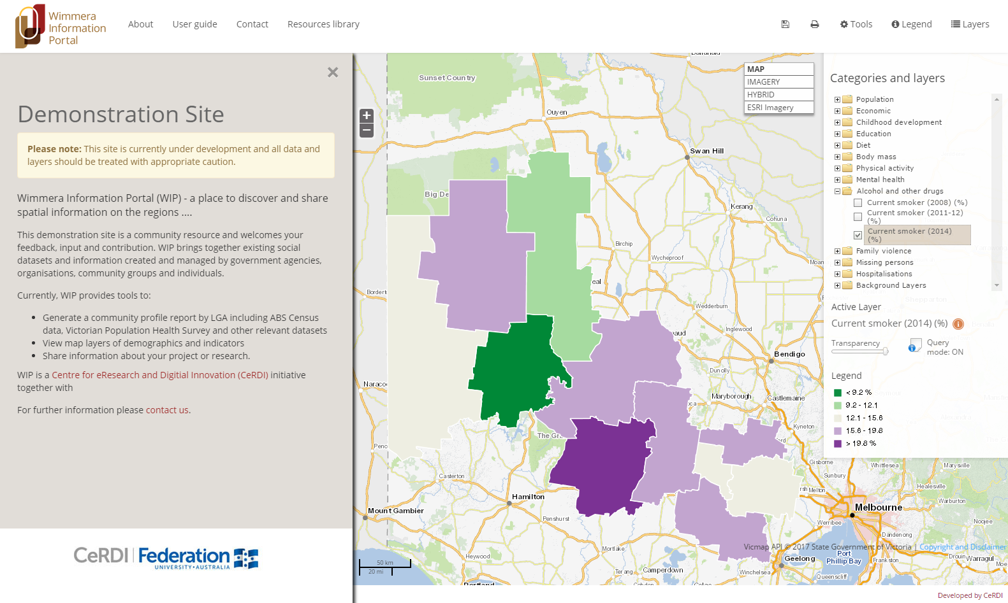
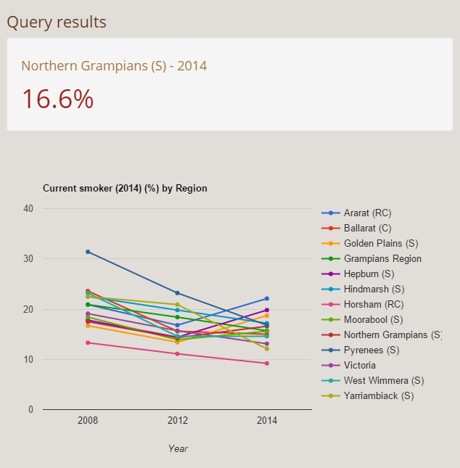
Exa
Proportion of Current Smokers (by LGA)
Trend over time

Slide 11
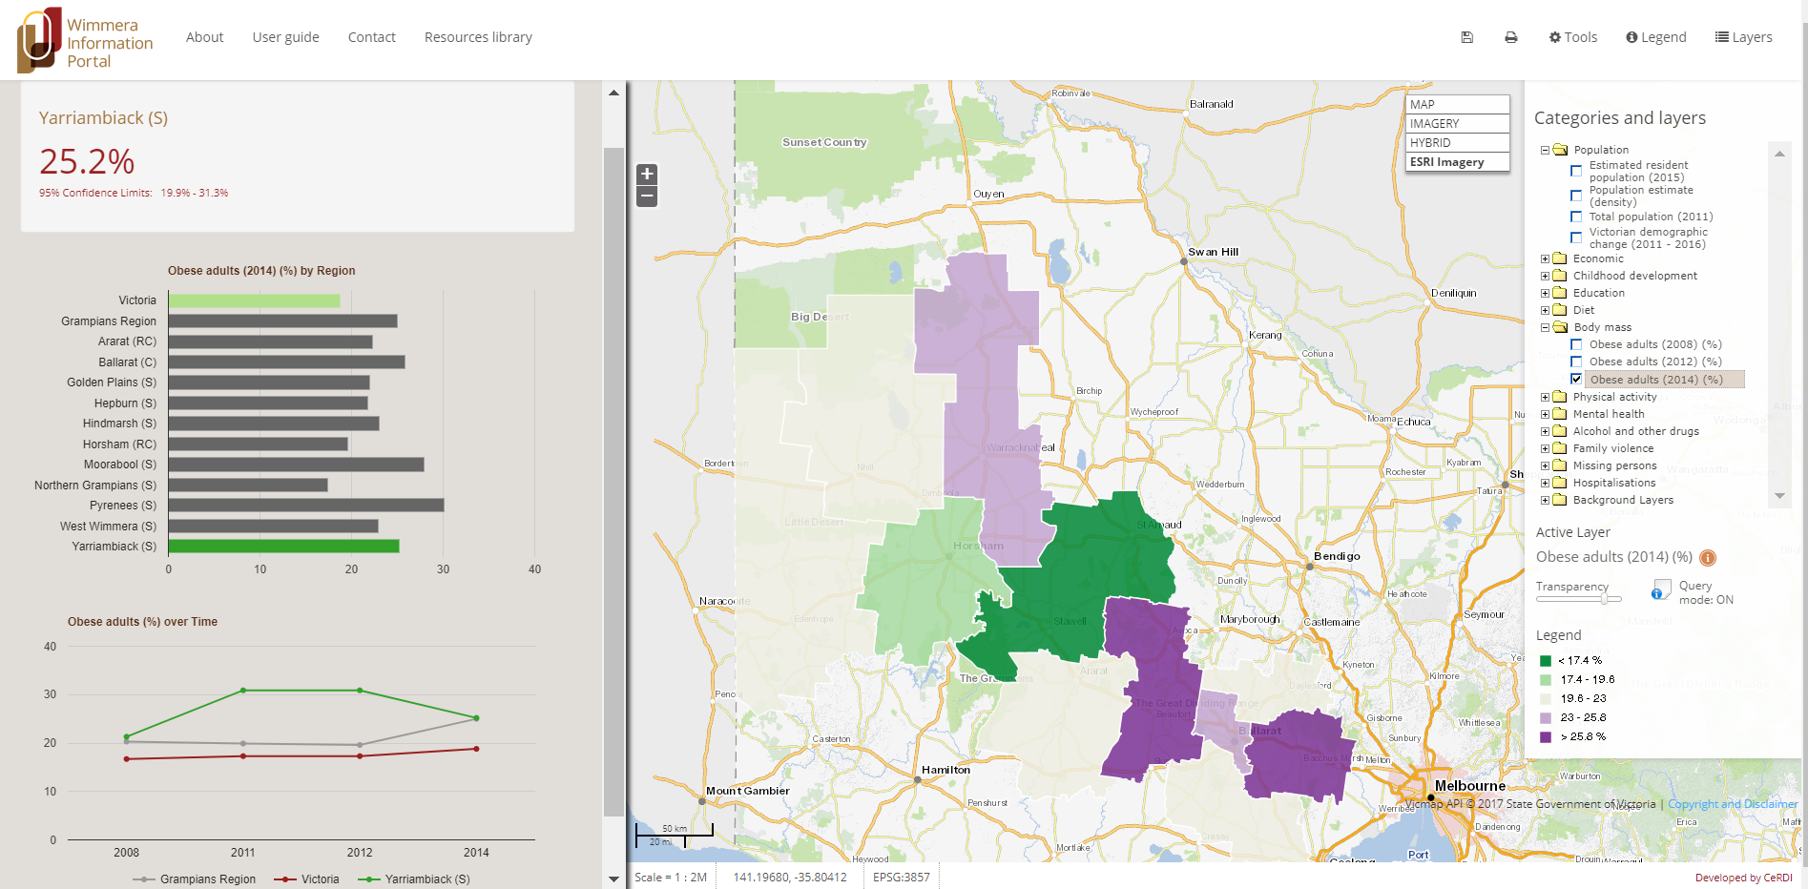
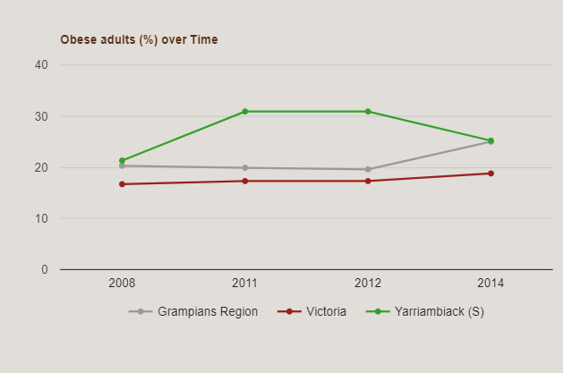
Exa
Proportion of Obese adults (by LGA)
2014
Trend in Yarriambiack

Slide 12
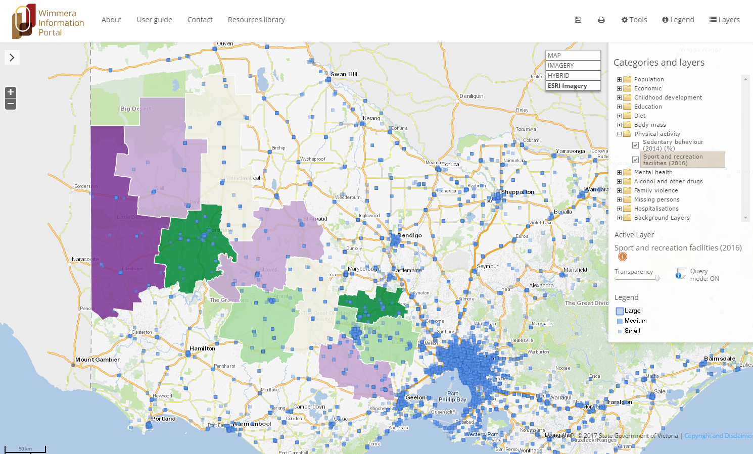
Sedentary behaviour (by LGA) + Sport and Recreation Facilities

Slide 13
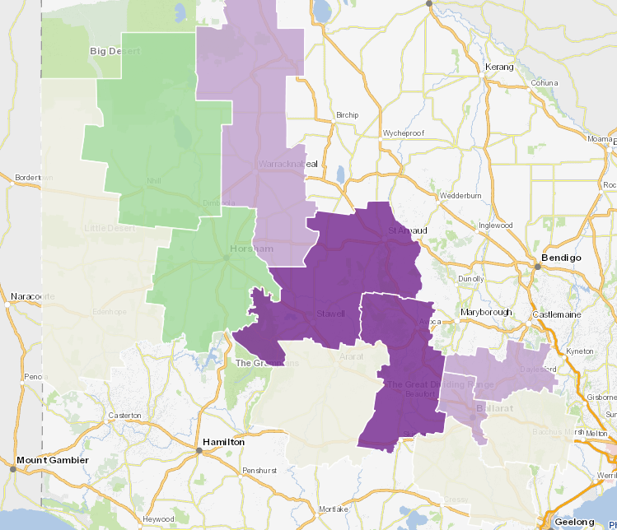
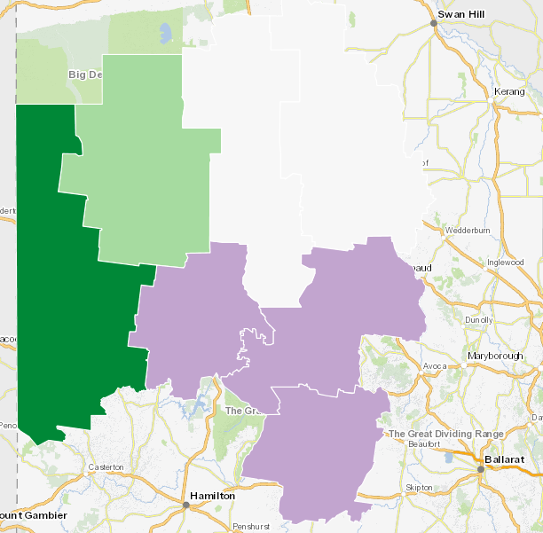
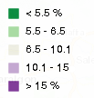
Comparisons
Psychological Distress (High - Very High)
Mental Health Warning Flags

Slide 14
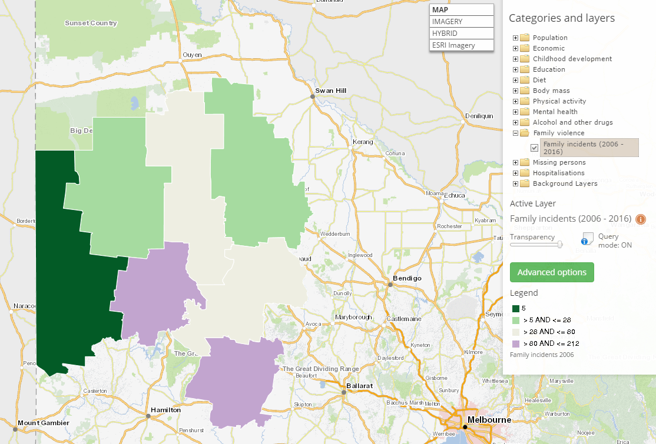
Family Incidents 2006

Slide 15
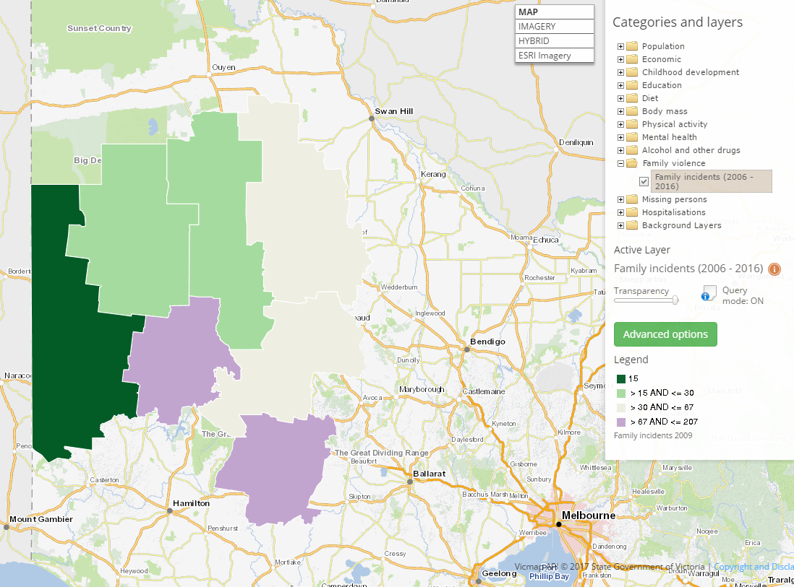
Family Incidents 2009

Slide 16
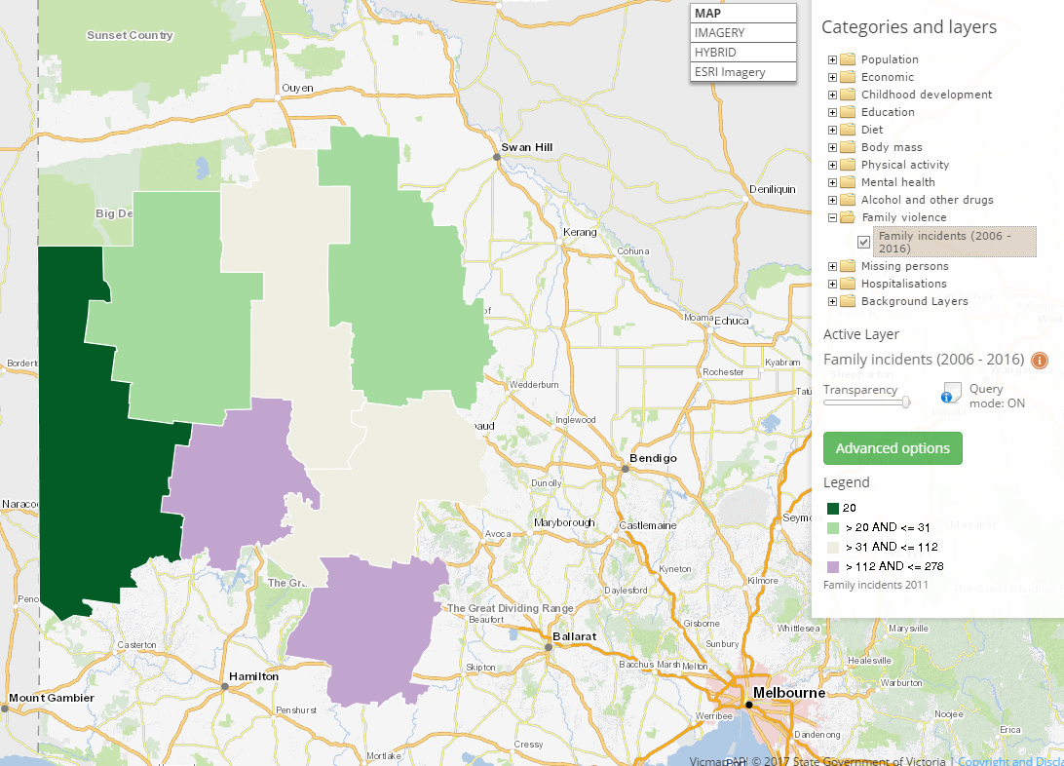
Family Incidents 2011

Slide 17
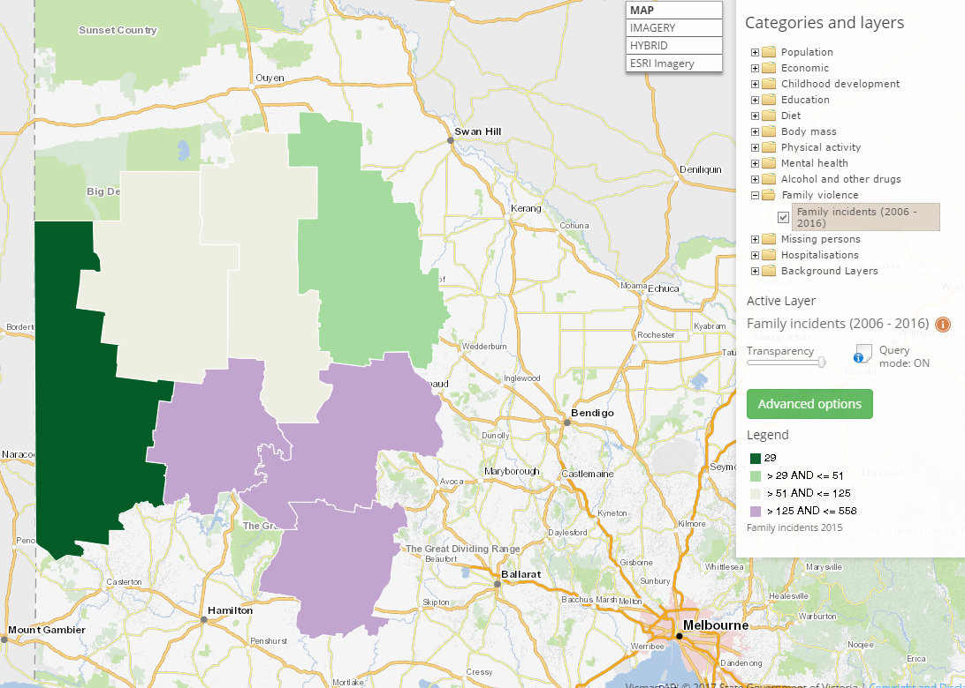
Family Incidents 2015

Slide 18
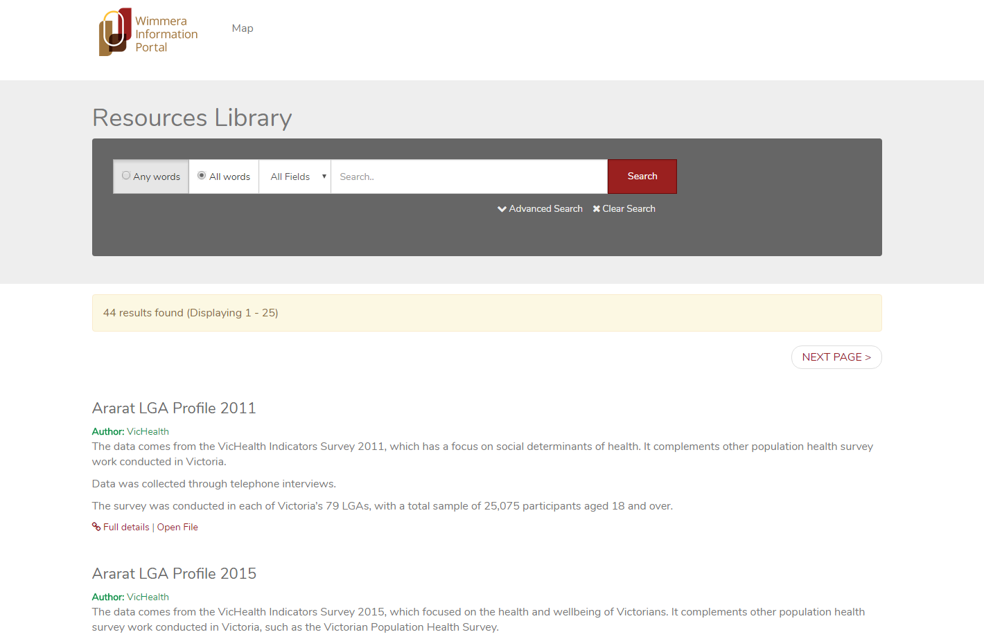

Slide 19
Challenges
Maps can be subjective
Small geographic areas are prone to classification problems
Sample sizes
Need to ensure representation of:
Confidence Intervals (CI)
RSE (Relative standard error)
Outliers
How to show trends
Data attributes change between data collections

Slide 20
WIP into the future
Informing place based interventions and evidence based practice
Providing efficiencies in need assessment, reporting and funding applications
Enhancing local responsiveness to needs within health and community services
Future planning for development of facilities, resources and interventions that address social and health inequalities
A mechanism to make previous research and intervention outcomes available

Slide 21
Moving from a pilot portal to a pragmatic research project
We are seeking funding from project partners for the next three years
This will enable us to leverage other funding sources e.g.
Public Sector Innovation Funding;
Other government or philanthropic funding sources;
Cooperative Research Centre Funding (e.g. Digital Health CRC; SMART Ageing CRC; and/or
FedUni contribution toward a Masters/PhD scholarship.

Slide 22
wip.cerdi.edu.au/
Visit the WIP:

